Slide 1
Attacking the firewall and stealing data over an encrypted channel

Slide 2
Introduction
In this lab, I will attack a firewall and steal data over an encrypted channel below shows the network topology for this lab. I will be using the external Kali Attack Machine on the wide area network, or WAN, to attack a web application on the network. I will use Metasploit and a Meterpreter payload to exploit a machine using an XAMPP WebDAV PHP Upload exploit. This exploit uses default WebDAV credentials on XAMPP servers. It uses supplied credentials to launch a Hypertext Preprocessor (PHP) Meterpreter payload.
Tools:
Kali
Zenmap
Metasploit
Nmap
Privilege Escalation

Slide 3
Objective
Use nmap/Zenmap to scan a network.
Use metasploit/meterpreter to exploit a vulnerability on a target.

Slide 4
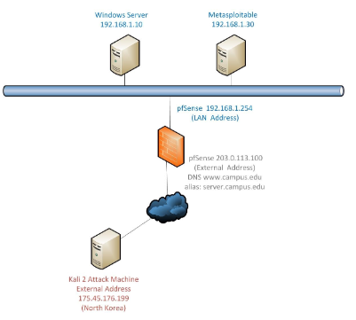
Topology

Slide 5

Pen testing process

Slide 6
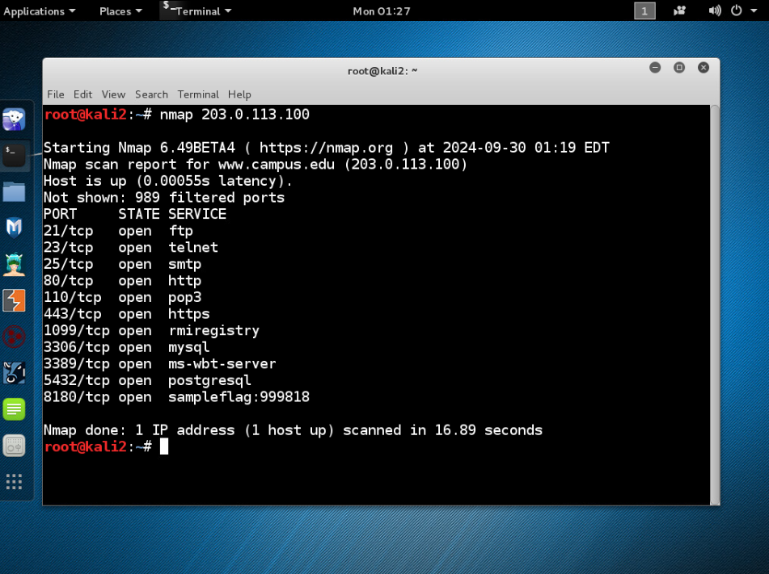
NMAP scan on the PF sense firewall

Slide 7
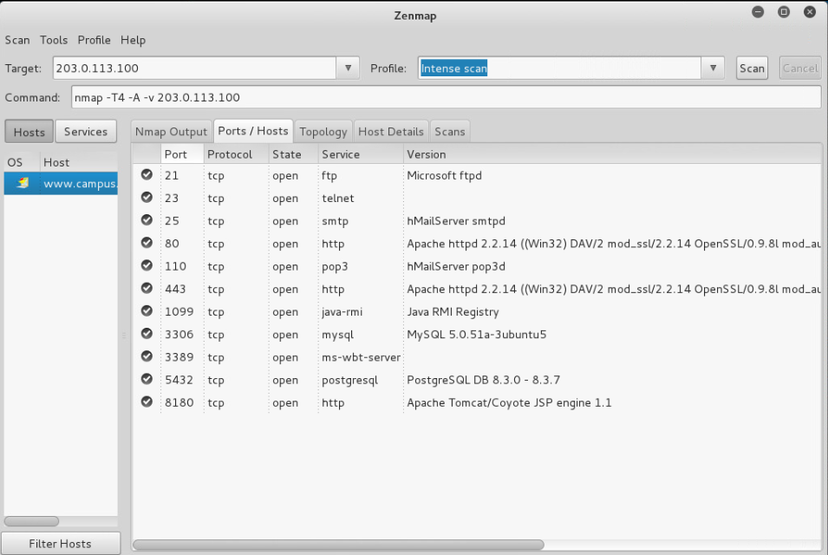
Zenmap scan of the machine

Slide 8
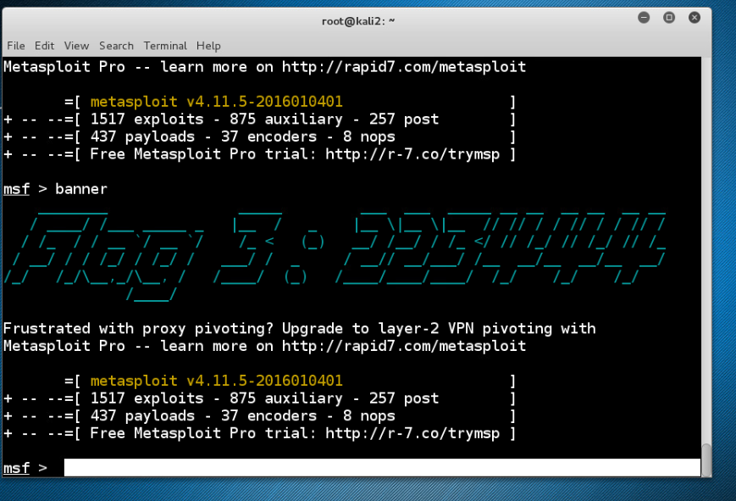
Launching msf console

Slide 9
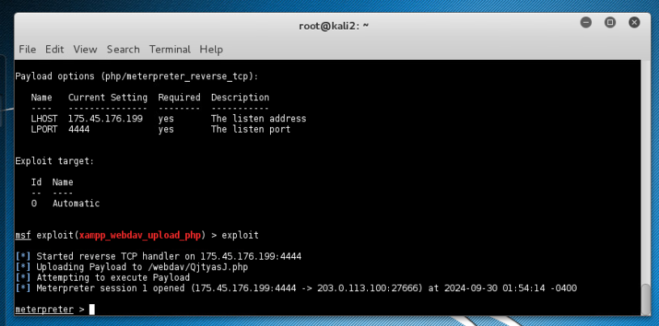
Launching msf console and then using xampp web dav upload php

Slide 10
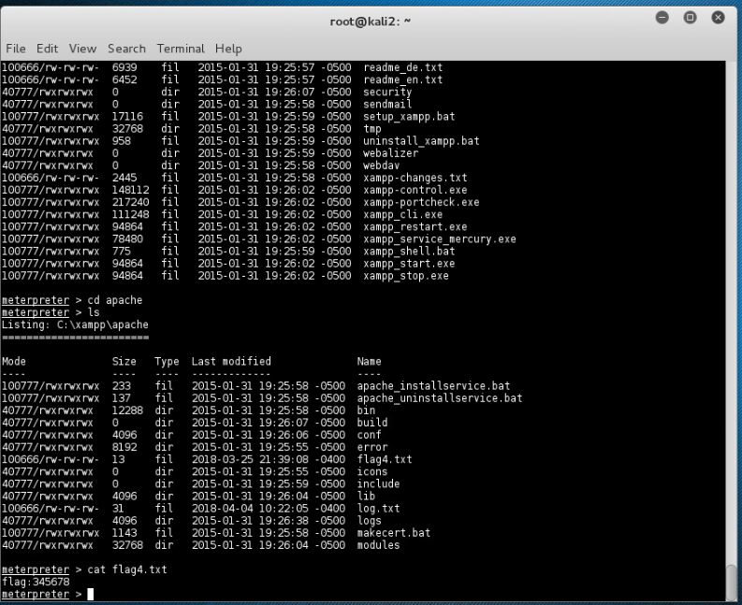
Snagging flag 4 for the challenge

Slide 11
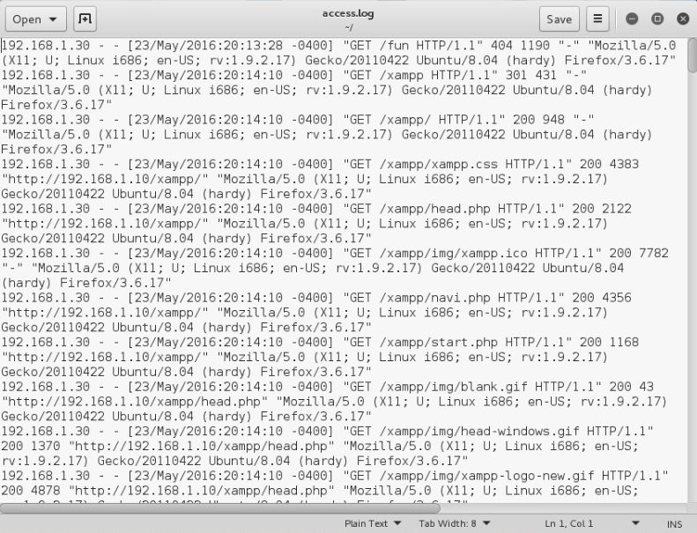
Viewing access file from apache

Slide 12
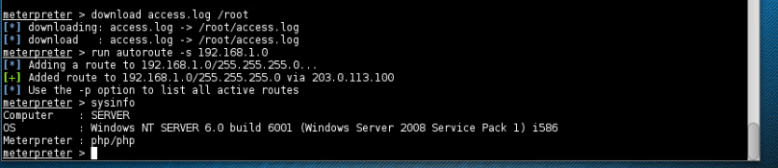
Compromised machine info

Slide 13
Compromised machine info

Slide 14
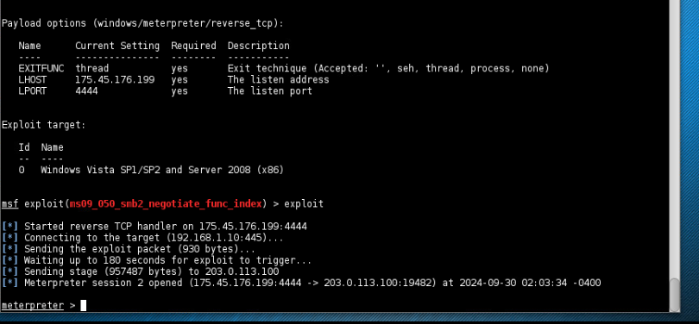
Conducting ms09_050 exploit

Slide 15
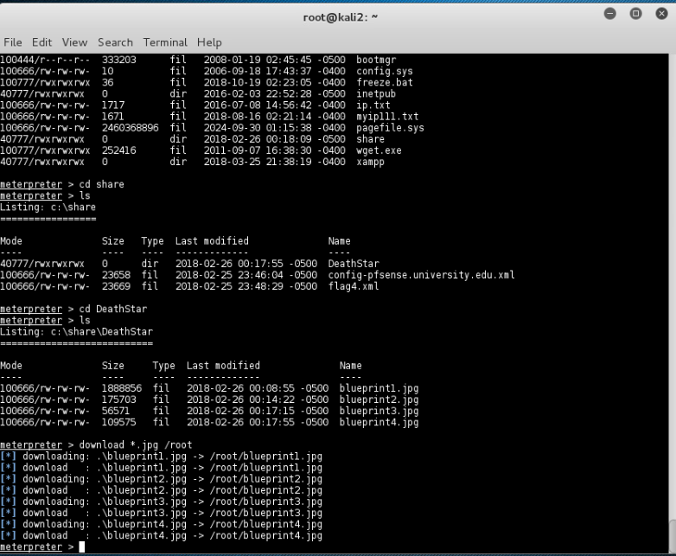
Stealing deathstar blueprints

Slide 16
conclusion
In this lab, I did attack a Windows web server from the wide area network, or WAN, with Metasploit and a Meterpreter PHP payload. Using nmap and Metasploit, the I did leverage vulnerable WebDAV/2 XAMPP Web Server machine and pivot to the internal network and exploit a vulnerable Windows Server machine SMB vulnerability. Then I , stole the blueprints for a DeathStar.

